Slide 1
GitHub
Website Overview

Slide 2

GitHub Repository
GitHub Overview
GitHub Repository - Code
Container that holds everything related to the project like code and documentation.
All files stored here are managed with git version control
Repository is often shorted to 'repo'
README.md
File that introduces the project and is displayed in repository's bottom.

Slide 3


GitHub Issues & Pull Request
GitHub Overview
Issues
Where users discuss about the code
Issues can be assigned to users and add label for easy reading
Pull request
represents change that a user wants to make to the repository
Example: Bob creates a Pull request to add the new README.md file.

Slide 4



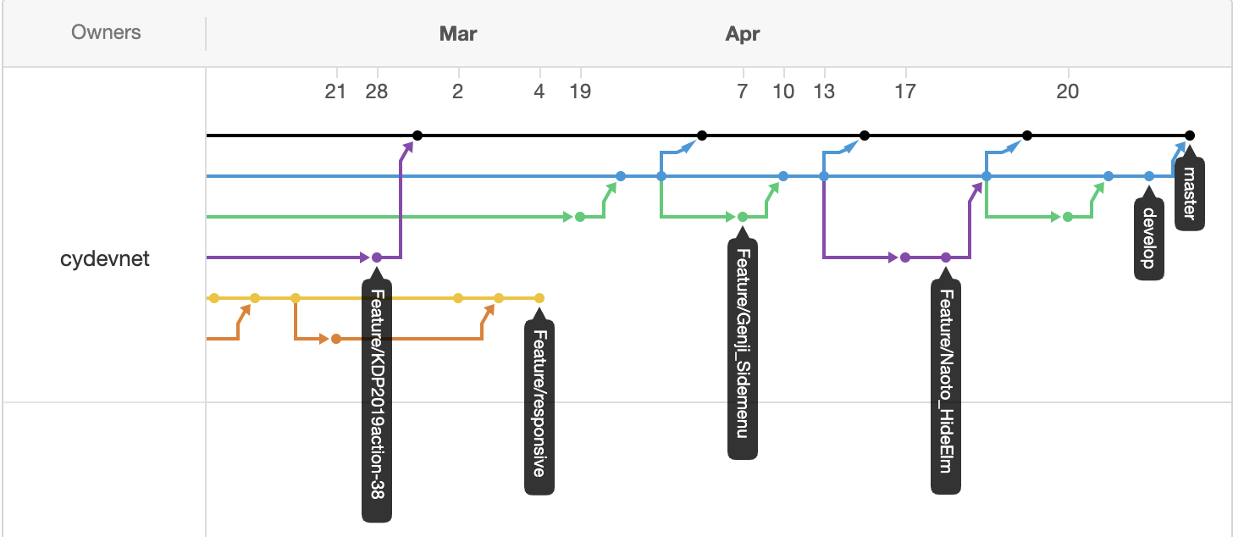
GitHub Overview
GitHub Overview
Project boards: Kanban-style task tracking board
Wiki: Create & store relevant project documentation
Insights: Analytics tools for your repository including:
Network Graph: Timeline visualization of the commits & branches
Pulse: View completed & . in-progress tasks

Slide 5
Parts of GitHub
GitHub Overview
Branch
Alternative timeline of the code
Ex: Master, Develop, Feature/xxx
Commit
Saving the file changes to the repo
Pull Request
Share the changes you are proposing with other
Merge Pull Request
Actually updating the Branch (like Master) with the changes,

Slide 6
Git Command-Line Cheat Sheet

Slide 7
Create a Repository
Git Command Line
Command | Description
git init | Initialize a local Git repository
git clone [url] | Clone (download) a repo from GitHub
git remote add origin [url] | Link a local repo to a remote repo
Example URL = https://github.com/user/repo
Notes:
https://github.github.com/training-kit/downloads/github-git-cheat-sheet/

Slide 8
Branches
Git Command Line
Command | Description
git status -v | see which branch is the current one
git branch [branch-name] | Create a new branch
git branch -d [branch] | Delete the specified branch
git checkout [branch] | switch the working directory
git merge [branch] | Merges the specified branch's history into the current branch.
Notes:
https://github.github.com/training-kit/downloads/github-git-cheat-sheet/

Slide 9
Sync Changes Between Local & Remote
Git Command Line
Command | Description
git fetch [remote] [branch] | Download history from the remote branch
git push [remote] [branch] | uploads the specified branch to [remote]
git pull [remote] | fetch & download content from [remote]

Slide 10
Snapshotting
Git Command Line
Command | Description
git add [file] | adds [file] to staging area
git status | Checks file status
git add -A | Add all new & modified files to the staging area
git commit -m "[message]" | Commit changes with a message
git rm -r [file] | Remove a file or directory

Slide 11
Make Changes
Git Command Line
Command | Description
git log | lists version history of the current branch
git log --follow [file] | version history specific to [file]
git diff [branch A] [branch B] | Shows the difference between the branches
git show [commit] | view details on the [commit]

Slide 12
Redo Commits
Git Command Line
Command | Description
git reset [commit] | revert back to [commit] Past-deleting undo operation
git revert [commit] | 'safe' way to revert back to [commit] Forward-moving undo operation
git revert HEAD | Create a new commit with the inverse of the last commit

Slide 13
Appendix

Slide 14
Window Specific Tutorials
Windows
https://www.datacamp.com/community/tutorials/git-push-pull

Slide 15
Resources
https://product.hubspot.com/blog/git-and-github-tutorial-for-beginners
https://guides.github.com/activities/hello-world/

Slide 16
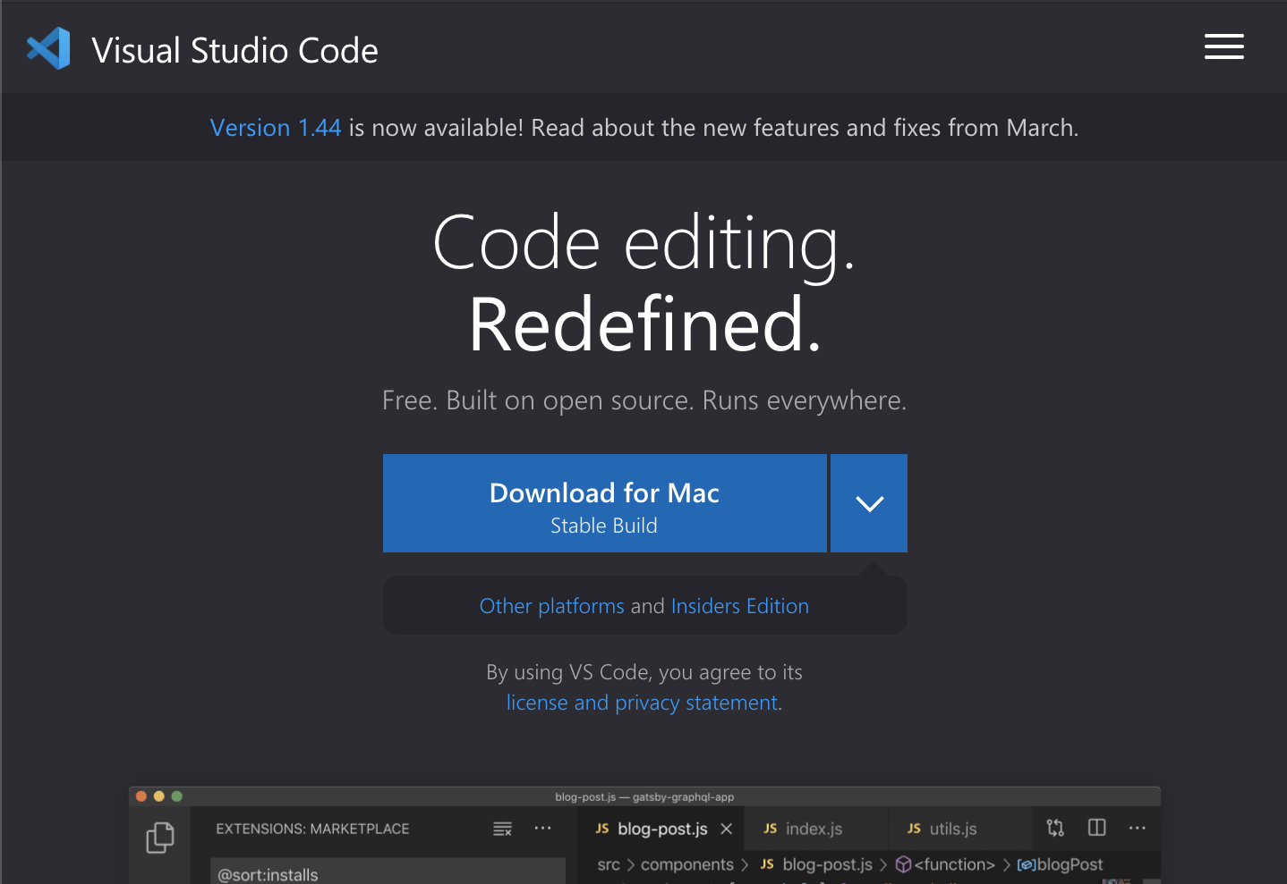
Visual Studio Code + Command Line
VS Code
Download Visual Studio Code:
code.visualstudio.com
Run VS Code from Command Line
Open VS Code
Open Command Palette
by pressing Command + Shift + P
Then type Shell & select Shell Command : Install code in PATH
Restart the terminal
Open VS Code in current directory by typing Code .

Slide 17
Recommend Plugins for VS Code
VS Code
Auto Close Tag
Auto Rename Tag
Beautify
Bracket Pair Colorizer
Material Theme
ES Lint
Highlight Matching Tag
HTML Snippets
Live Server
Material Icon Theme
nbsp-vscode
Replace curly quotes
Settings Sync
zenkaku

